Slide 1
Fifty Years of Accident Analysis & Prevention: A Bibliometric and Scientometric Overview
Xin Zou, Hai L. Vua, Helai Huang
Q1; IF=4.993
2022/6/13

Slide 2
Section 1: History of AA&P
Section 2: Bibliometric Methods
Section 3: Results(citation, reference burst detection analyses)
Section 4:Summary

Slide 3
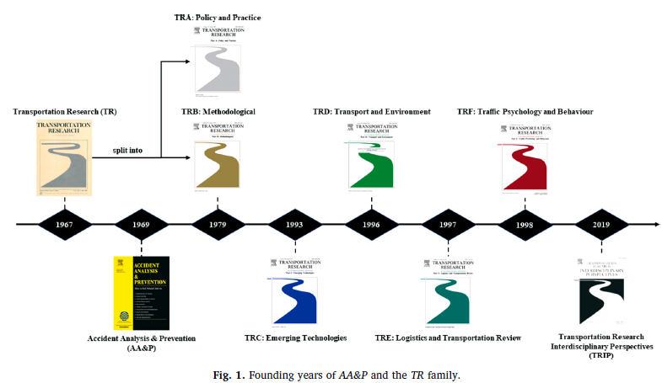
Section 1: History of AA&P
Accident Analysis & Prevention (AA&P) was founded by Professor Frank A. Haight in 1969 two years after establishing Transportation Research (TR).
Notes:
跨学科视角

Slide 4
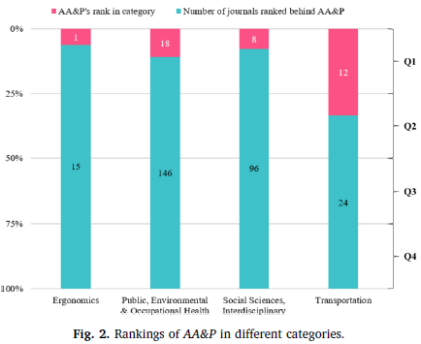
AA&P’s “ESI Total Citations” ranks 25th among the 2,234 journals in Social Sciences, top quartile-1 journals.
Citations of AA& P in 2018 is 17,335 in Web of Science and impact factor (IF) is 3.058.

Slide 5
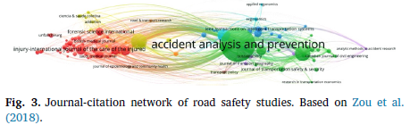
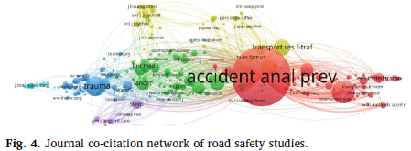
AA&P is at the center of both the journal-citation and journal co-citation networks of road safety studies .
Dominates the field with the highest numbers of publications (Fig. 3) and citations (Fig. 4).

Slide 6
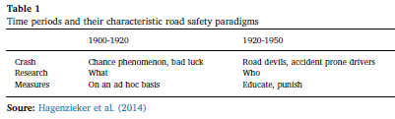
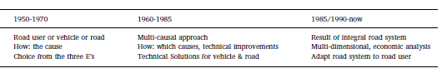
AA&P is the most productive journal in road safety area (Hagenzieker et al., 2014).
Notes:
Hagenzieker et al. (2014) conducted a quantitative analysis based on keyword frequencies to investigate the developments in the history of road safety research (Table 1).

Slide 7
Early stage AA&P
Exposure
Crash risks
Crash rates
Injury severity
Crash cause
Later
Haddon matrix (1968)
After
Empirical Bayes (EB) approach (1997)
Road safety milestone: Highway Safety Manual
Nowadays
Intelligent, connected, autonomous
Automation, information science, artificial intelligence technologies
Redefine road safety field

Slide 8
Section 2: Bibliometric and scientometric methodology

Slide 9
2.1 Data source and processing
Source data: Web of Science(WOS) Core Collection
Keyword: ACCIDENT ANALYSIS "AND" PREVENTION
Total: 5719 publications (March 11, 2019)
2.2 Analytical methods and tools
Research methods:
Bibliometric analysis
Quantitative analysis
Annual distribution, contributing countries, productive organizations, core authors
Mapping knowledge domain analysis
Citespace: “dual-map overlays” tool
Combination: citing and cited journal data
VOSviewer and CiteSpace : knowledge map(AA&P’s main topics, knowledge bases, research frontiers, and future trends)

Slide 10
Section 3: Results(citation, reference burst detection analyses)

Slide 11
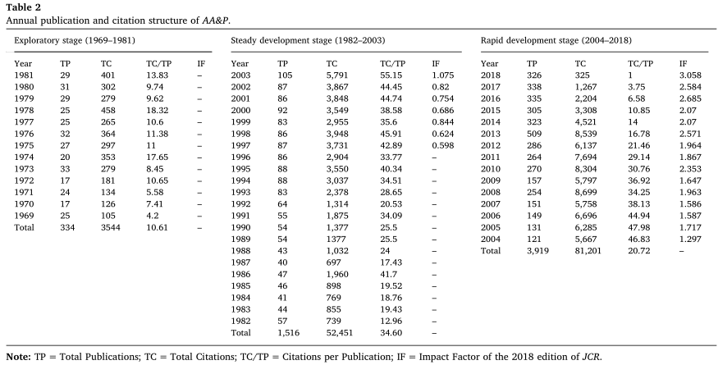
3.1.1 Publication and citation structure of AA&P
Annual publication and citation structure of AA&P(1969 ~2018)
5,769 papers ;121 volumes
average :115.38 papers per year
47.68 papers per volume

Slide 12
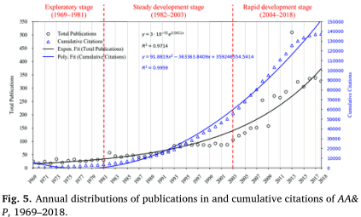
Exploratory stage (1969–1981)
Steady development stage(1982–2003)
Rapid development stage (2004–2018)

Slide 13
Exploratory stage (1969–1981)
Publications (25.69 papers/year)
Slow growth rate(0.33 papers /year)
Steady development stage(1982–2003)
Total publications:1516 papers(68.91 papers/year)
Steady growth rate(2.29 papers /year)
Rapid development stage (2004–2018)
Total publications:1516 papers(261.27 papers/year)
Rapid growth rate(14.64 papers /year)
Publication peak: 509 papers(2013)

Slide 14
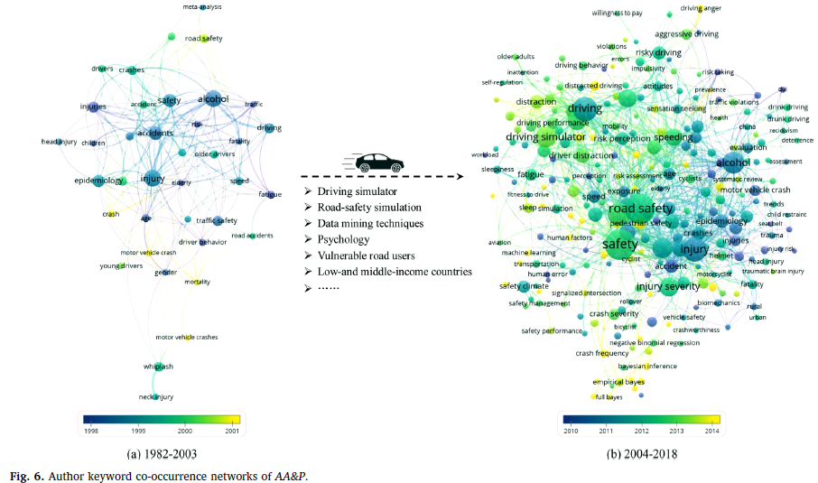
In order to reflect the research focuses at each stage, keyword co-occurrence net-works are produced (Fig. 6).
Notes:
为了反映各阶段的研究重点，我们生成了关键词共现网络(图6)。

Slide 15
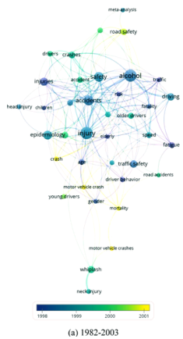
Keywords:
Alcohol
Epidemiology
Whiplash(颈部扭伤)
Fatigue
Older/young drivers
Speed
Driver behavior
Risk
Head/neck injury
Mortality(死亡率)

Slide 16
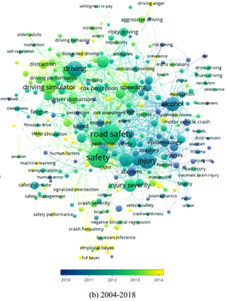
New keywords:
Driving simulator
Driver distraction
Perception
Simulation
Bayesian inference
Artificial neural networks
Bayesian network
Road-safety-simulation
software
Notes:
(贝叶斯推理)

Slide 17
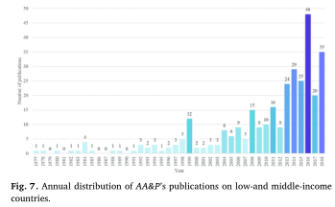
Since 2004, more and more studies have been conducted in low- and middle-income countries (Fig. 7).
93% of traffic deaths occur in these countries.
60% of the world’s vehicles can be found in them (World Health Organization (WHO, 2020).

Slide 18
15769 papers were cited 137196 times.
Average of 23.78 citations per publication.
The highest number of citations of a single paper is 404.
Papers published in 2008 had the most citations of 8699.

Slide 19
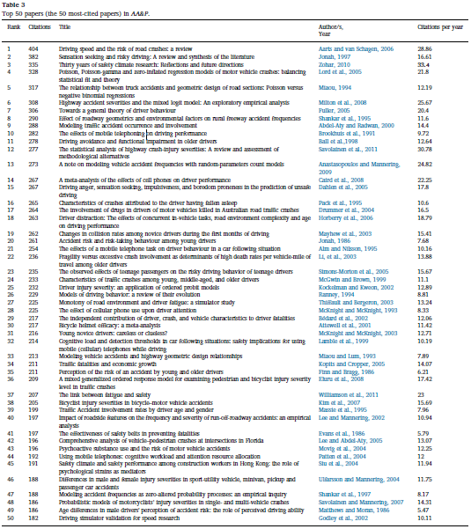
3.1.2 Highly Influential papers in AA&P

Slide 20
Top papers
Most-cited paper: Driving Speed and the Risk of Road Crashes: A Review(Aarts and van Schagen, 2006)
Highest number of citations per year: Thirty Years of Safety Climate Research: Reflections and Future Directions (Zohar, 2010).
Oldest paper: The Effectiveness of Safety Belts in Preventing Fatalities (Evans, 1986)
Youngest paper: The Statistical Analysis of Highway Crash-injury Severities: a Review and Assessment of Methodological Alternatives(Savolainen et al.,2011)
Notes:
公路交通事故伤害严重程度的统计分析:替代方法的回顾和评估

Slide 21
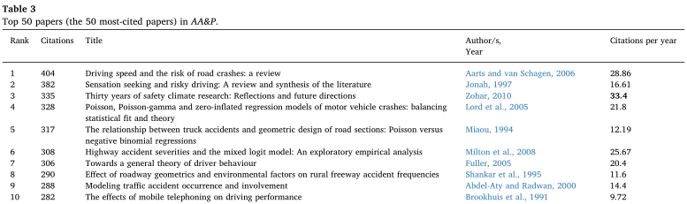
Top 10 paper contributions
Three most-cited papers in AA&P are review papers, including driving speed, sensation seeking, and safety climate.
Four authors develop and evaluate the performance of “crash frequency modeling analysis.
Two papers “effects of hazard and risk perception on driving behavior.”
One paper “crash-injury severity modeling analysis”.

Slide 22
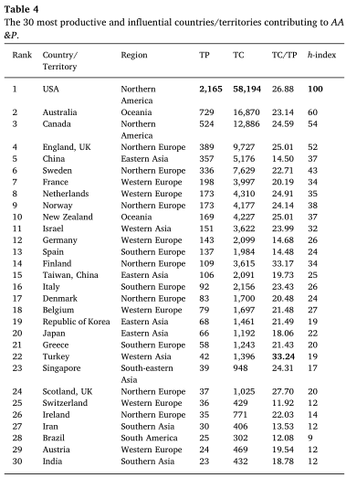
3.1.3. Leading countries, organizations and authors in AA&P

Slide 23
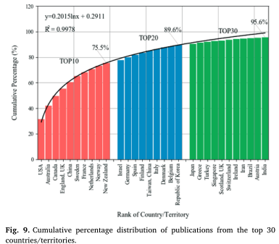
The cumulative percentage distribution of publications for top 30 countries.
Top 10 of these account for 75.5% of the publications;
Top 20(89.6%);
Top 30 for almost all (95.6%) .

Slide 24
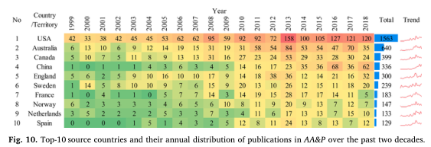
USA ranked first over the past two decades, followed by Australia and Canada.
China has shown strong growth in recent years.

Slide 25
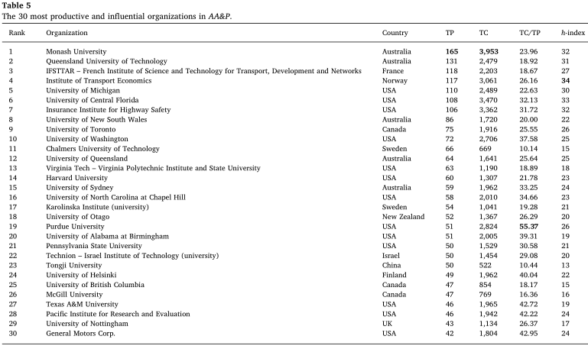
The number of organizations located in the USA is the largest (13, or 43%), followed by Australia (5, or 17%) and Canada (3, or 10%).
Purdue University (USA) received the most (55.37) citations per publication.
Institute of Transport Economics (Norway) has the highest h-index, at 34.

Slide 26
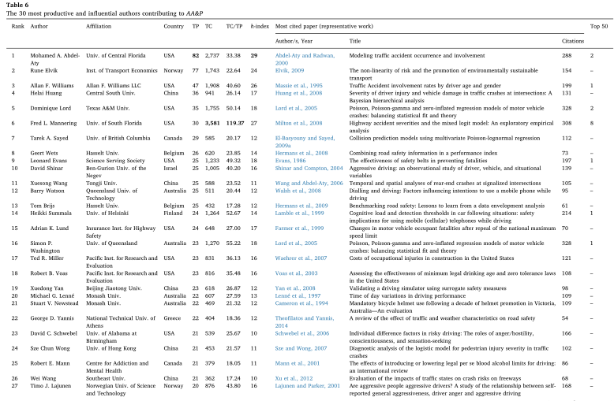
Professor Mohamed A. Abdel-Aty (University of Central Florida) tops the list with
82 papers and the highest h-index (29).
The next is Professor Rune Elvik (Institute of Transport Economics), with 77 papers that received 1,743 citations.
Professor Fred L. Mannering (University of South Florida) ranks first in the categories of “TC” and “TC/TP” ,eight “top-50 papers”, making him the most influential.

Slide 27
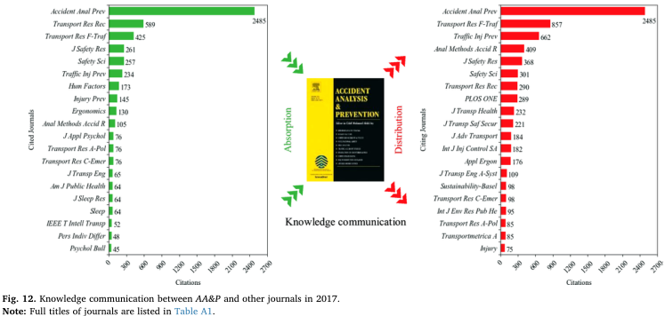
Top 20 journals cited by AA&P are on the left side, while those citing AA&P are on the right.
AA&P is the most cited and that it cites the most.
AA&P has widely cited and been cited in high-impact journals in other fields, such as Applied Psychology, Industrial Engineering and Clinical Neurology.
Interdisciplinary of AA&P and receives the attention from other fields.

Slide 28
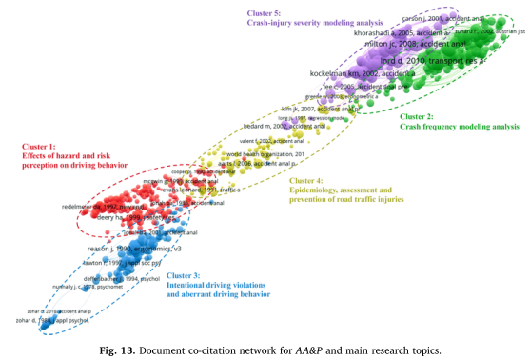
3.2. Co-citation analysis:main research topics and knowledge bases

Slide 29
Cluster 1 (red): Effects of hazard and risk perception on driving behavior
Cluster 2 (green): Crash frequency modeling analysis
Cluster 3 (blue): Intentional driving violations and aberrant driving behavior
Cluster 4 (yellow): Epidemiology, assessment and prevention of road traffic injuries

Slide 30
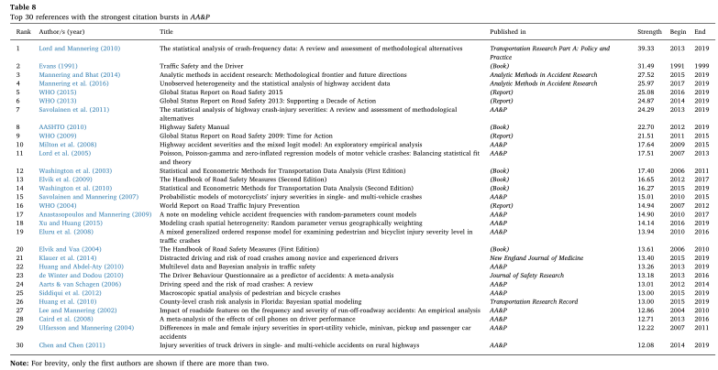
3.3. Reference burst-detection analysis: hotspots and trends
通过参考文献突发检测分析，识别出给定时期内引用突发最强的参考文献(一个突发代表该参考文献被引用的频率(Chen, 2019))，更好地确定AA&P的研究前沿。
突发文献是一种能够量化论文被引频次突然提升的重要文献类型。
利用CiteSpace中的“爆发检测”功能，基于Kleinberg算法(Kleinberg, 2003)，得到AA&P中引文爆发最强的30篇论文，详细的信息如表8所示。

Slide 31
如表8所示，爆发强度最高的论文是Lord and Mannering(2010)的《The Statistical Analysis of Crash-frequency Data: A Review and Assessment of Methodological Alternatives》，2013年以来突发强度为37.26。
该文章是“碰撞频率建模分析”的基础，这表明该文章在这一主题的研究演变中具有强大的力量，这一领域的研究将继续吸引AA&P的最大兴趣。
爆发强度次之的是Evans(1991)的《Traffic Safety and The Driver》，爆发强度为31.49，爆发周期为1991 - 1999年。
这本经典著作分析了导致车祸的工程、环境和人为因素，讨论了乘员保护装置的有效性和相应的法律，并在安全、机动和其他价值观的背景下介绍了交通安全。

Slide 32
4.1 总结
从期刊年发文量来看， AA&P的发展经历了探索阶段(1969-1981年)、稳定发展阶段(1982-2003年)和快速发展阶段(2004 -至今)，并呈指数级增长。
AA&P引用最多的期刊位于“心理学、教育、社会”这一集群，并且广泛吸收了其他类别期刊的知识，如“系统、计算、计算机”和“健康、护理、医学”这类期刊，跨学科性很强。
通过文献共被引分析，AA&P收录的主要研究主题为“危害和风险感知对驾驶行为的影响”、“事故发生频率建模分析”、“故意驾驶违法和异常驾驶行为”、“道路交通伤害的流行病学、评估与预防”和“事故-伤害严重程度建模分析”。
通过文献突发检测分析，Lord和Mannering(2010)、Evans(1991)、Mannering和Bhat(2014)、Mannering等人(2016)以及WHO(2015)的论文被认为是引文突发最强的。此外，碰撞频率和碰撞损伤严重程度的研究显然是并将继续是AA&P的重要课题。

Slide 33
4.2 未来方向
随着智能、互联、自动驾驶汽车技术的快速发展，安全成为新一代交通系统的首要研究课题。
在过去的两年里，AA&P上出现了一些关于安全性的研究，涉及的主题包括困倦、疲劳和注意力分散等。
智能汽车不仅能够感知其他道路使用者(尤其是骑自行车的人和行人)，还应该能够识别他们的手势，甚至预测他们的行为，做出更明智的决策，降低驾驶风险。

